Slide 1
Impervious Cover Segmentation using Computer vision (U-Net and GANs)

Slide 2
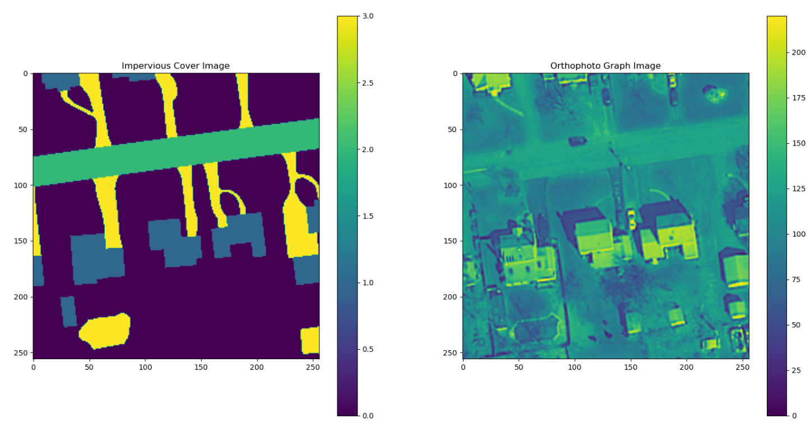
Input and Target Data
Input data is Orth photograph Image with 256 distinct values (RGB o to 255).
Target data is Impervious cover Image with 4 classes (0= grass or tress, 1= road, 2= buildings, 3= other impervious cover).
Both of them have Geo-Coordinates associated with them.
We have Input-Target pair data for state of Connecticut (currently using 2012 data alone).

Slide 3
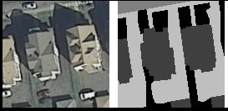
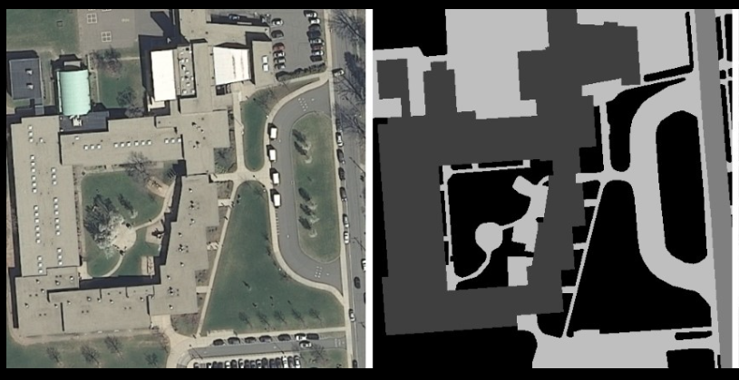
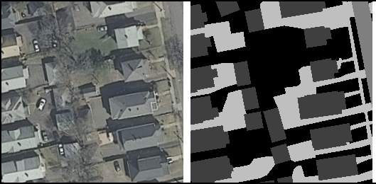
Resizing Images
Raw data size is 1000 by 1000 pixels.
Images are cropped into 3 sizes (128 by 128, 256 by 256, and 512 by 512).
128 by 128 Input-Output pair
512 by 512 Input-Output pair
256 by 256 Input-Output pair

Slide 4
Models
Each of 3 image sizes is experimented with 3 different U-Net architectures (9 total). Below architectures for image 256 by 256.
 | Architecture 1 | Architecture 2 | Architecture 3
Encoder | Input: 256, 256, 3 256, 256, 16 128, 128, 32 64, 64, 48 32, 32, 64 Bridge: 16, 16, 128 | Input: 256, 256, 3 256, 256, 32 128, 128, 64 64, 64, 128 32, 32, 256 Bridge: 16, 16, 512 | Output: 256,256,4 256, 256, 32 128, 128, 64 64, 64, 128 32, 32, 256 16, 16, 512 Bridge: 8, 8, 1024
Decoder | Bridge: 32, 32, 128 32, 32, 64 64, 64, 48 128, 128, 32 128, 128, 32 Output: 256,256,4 | Bridge: 32, 32, 512 32, 32, 256 64, 64, 128 128, 128, 64 256, 256, 32 Output: 256,256,4 | Bridge: 16, 16, 1024 16, 16, 512 32, 32, 256 64, 64, 128 128, 128, 64 256, 256, 32 Output: 256,256,4
Train-Test split
Training Samples = 866
Validation Samples = 217
Test Samples = 1500

Slide 5
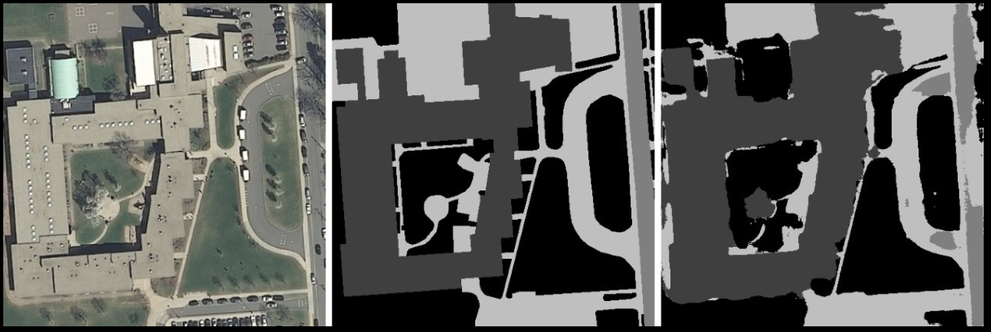
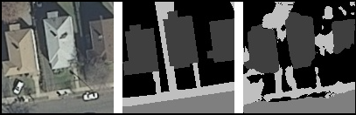
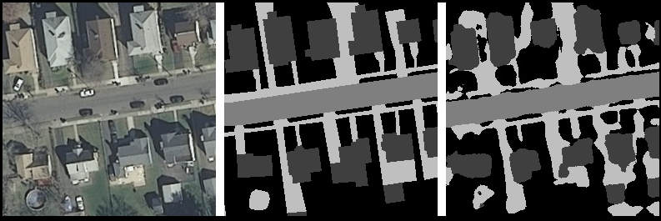
Test data Results
Input GT MP
Input GT MP
Input GT MP
Input : Input RGB image
GT : Ground Truth (labelled Manually)
MP : Model Predictions (Generated by U-Net)

Slide 6
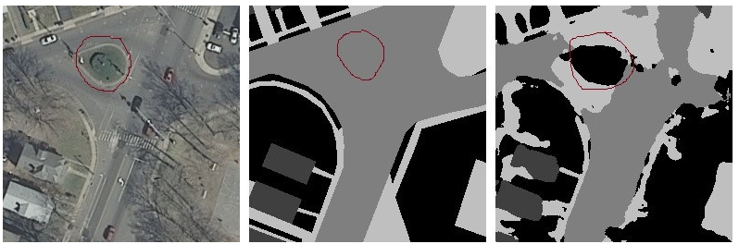
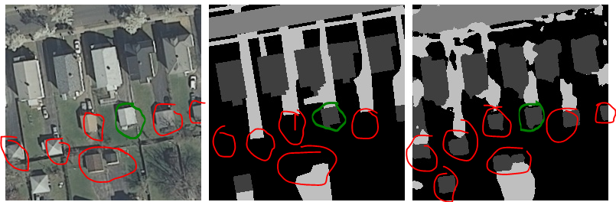
Test data Results
Model can make predictions which are mislabeled in ground truth data (red color).
Input Ground Truth Model Predictions
Input Ground Truth Model Predictions

Slide 7
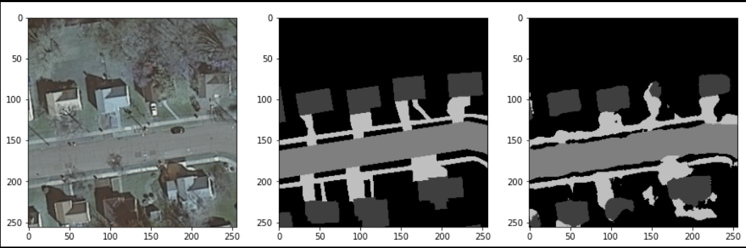
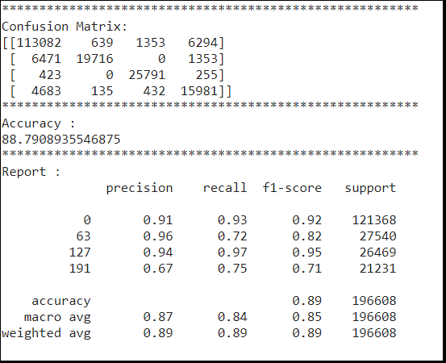
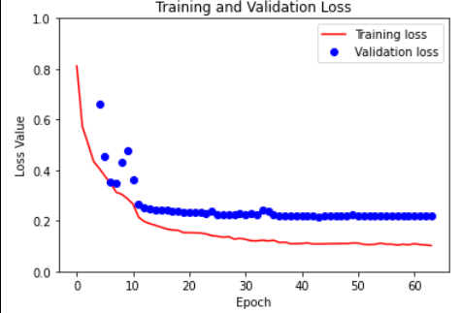
Test data Results
Input Ground Truth Model Predictions
Evaluation metrics (Accuracy, Precision, Recall, F1-Score)

Slide 8
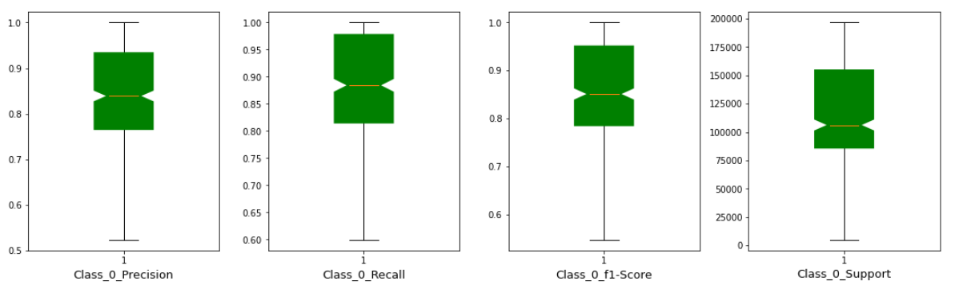
Class 0 = Tree cover; metrics for 358 samples

Slide 9
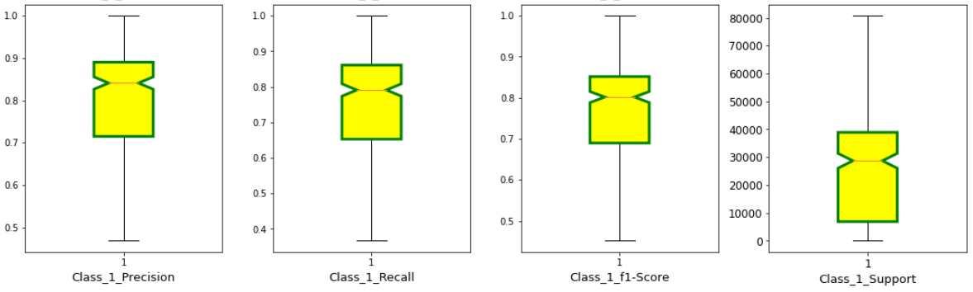
Class 1 = House; metrics for 358 samples

Slide 10
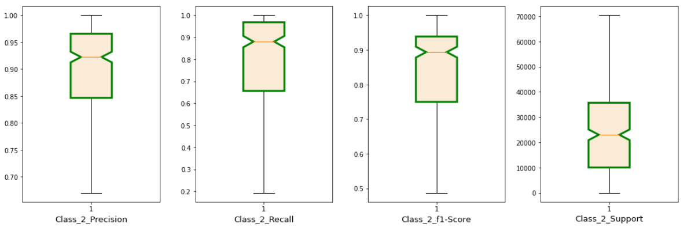
Class 2 = Roads; metrics for 358 samples

Slide 11
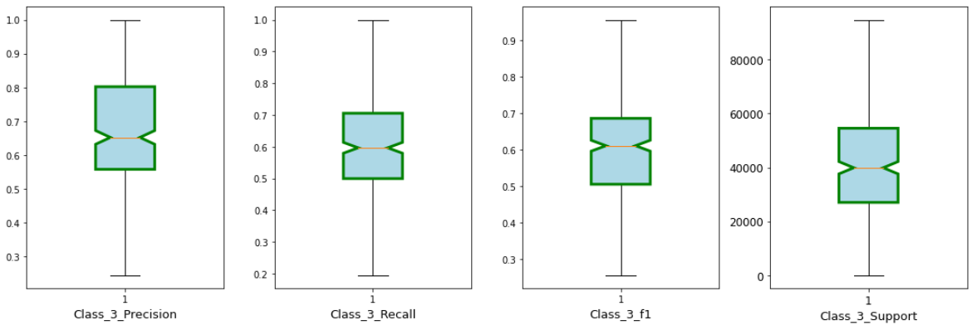
Class 3 = Other Impervious cover; metrics for 358 samples

Slide 12
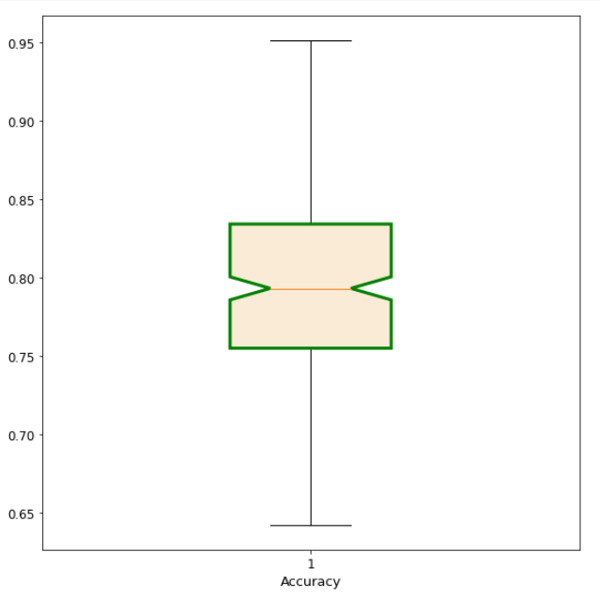
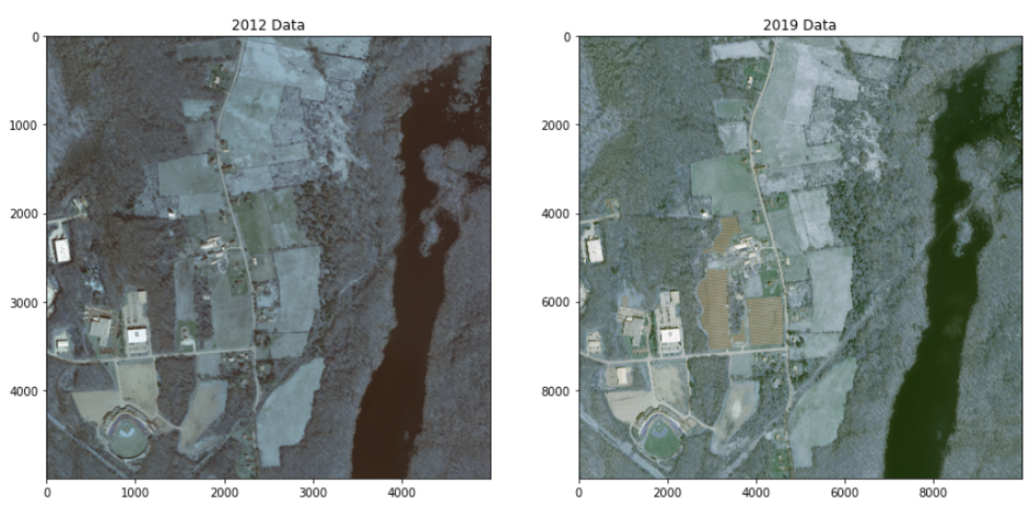
Accuracy
One pixel in 2012 is represented with 4 pixels in 2019

Slide 13
Challenges
Improper labeled ground data.
When images are taken not in NADIR position, from this side view trees appears to overlap with road.
Trees on side of road making difficult for network to classify other impervious cover.
To do
Perform change detection in impervious cover from 2012 to 2019.
Test with 2016 and 2019 data.
Test with different State and Counties.
Make a custom data set for training and testing to evaluate true accuracy.
No impervious cover segmentation for 2019, can we do it?

